Slide 1
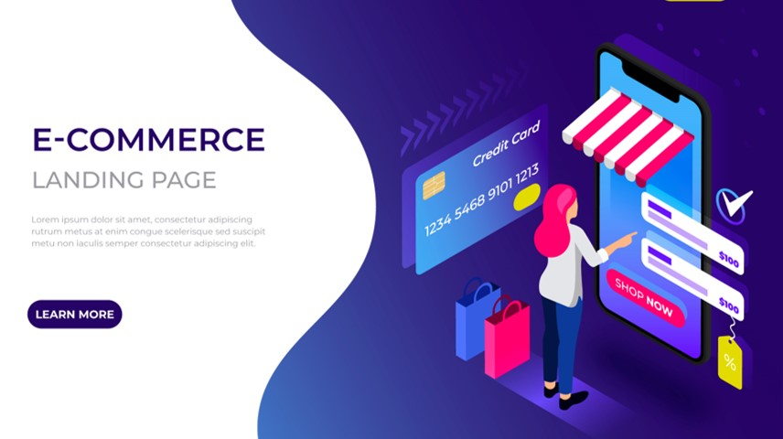
Home
XYZ E-COMMERCE
Customer Details
ANNUAL REPORT
Analysis
Dashboard

Slide 2
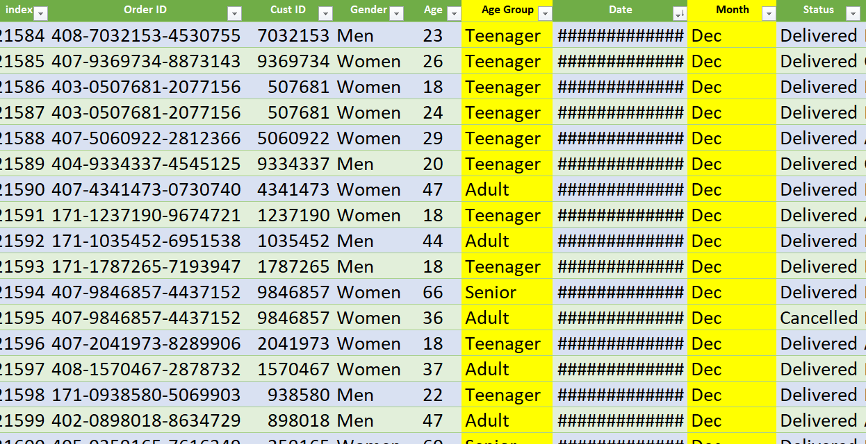
Home
Customer Details
Analysis
Dashboard

Slide 3
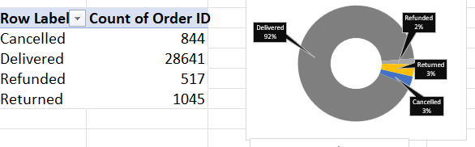
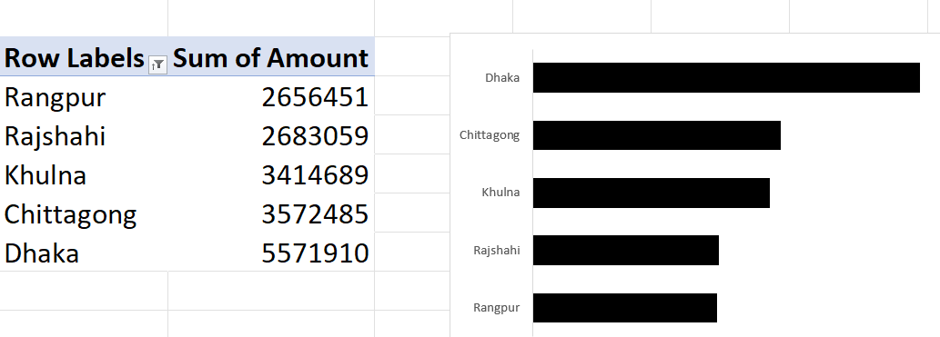
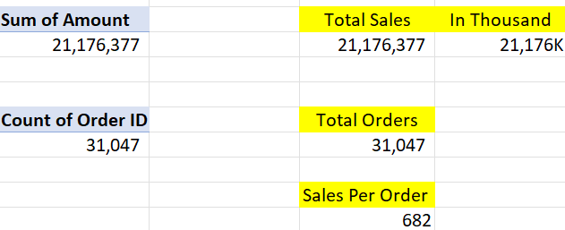
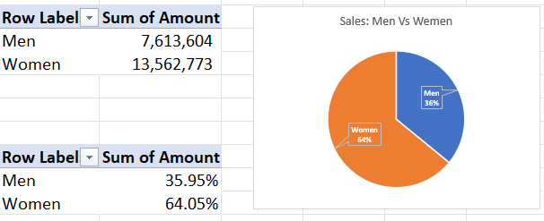
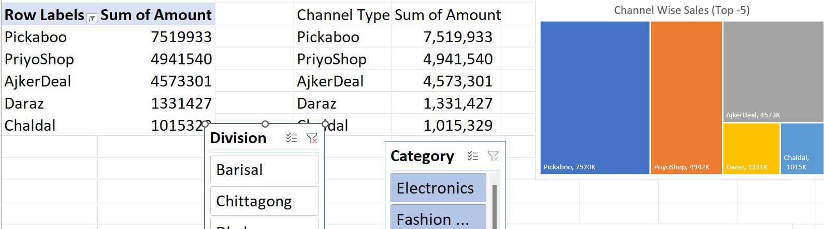
Home
Customer Details
Analysis
Dashboard

Slide 4
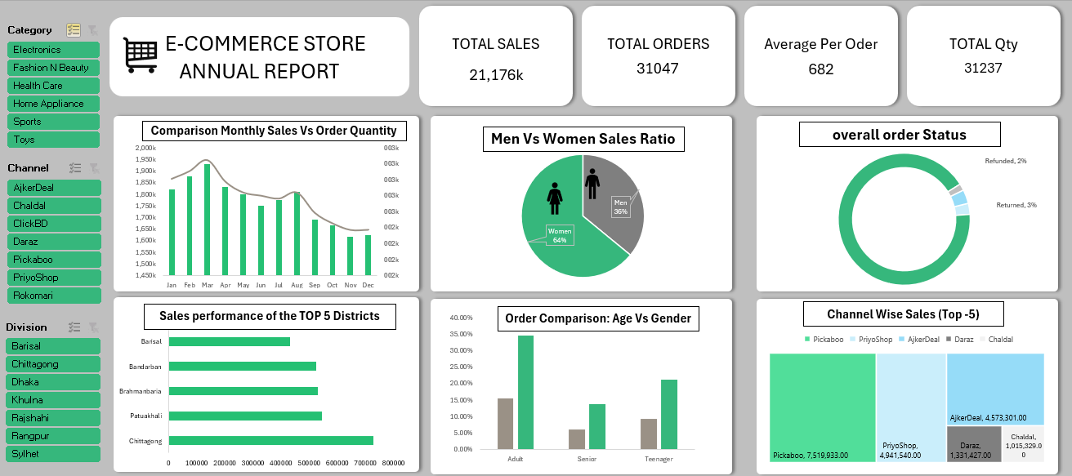
Home
XYZ E-COMMERCE
Customer Details
ANNUAL REPORT
Analysis
Dashboard

